Slide 1
NSL Sugars (Tungabhadra) Limited

Slide 2
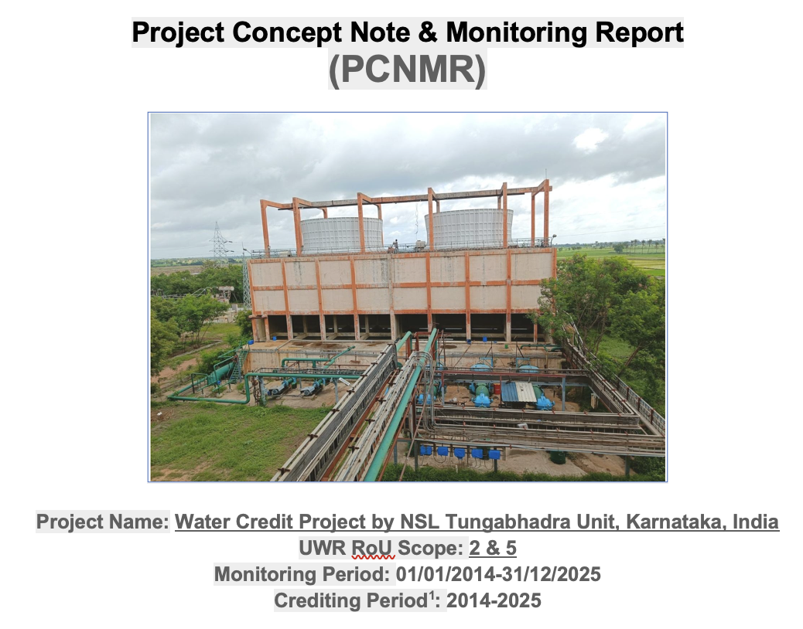


UWR Basic Details

Slide 3
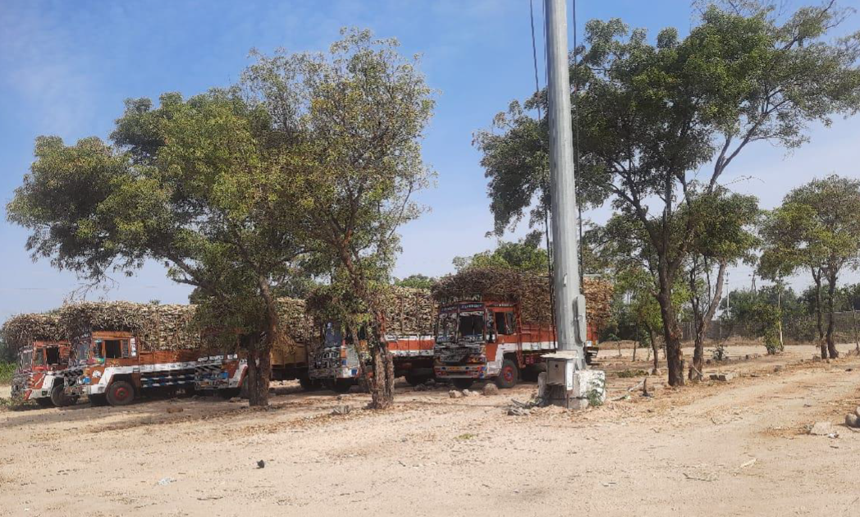
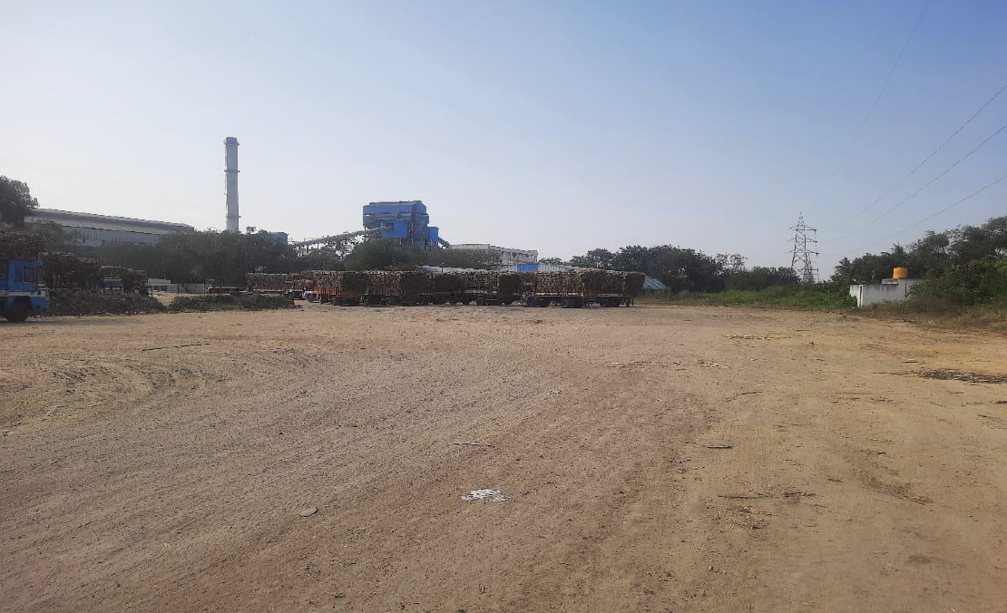
Sugar Factory premises
Picture 1: (a) Parking area for cane transporting vehicles and (b) Cane collection area

Slide 4
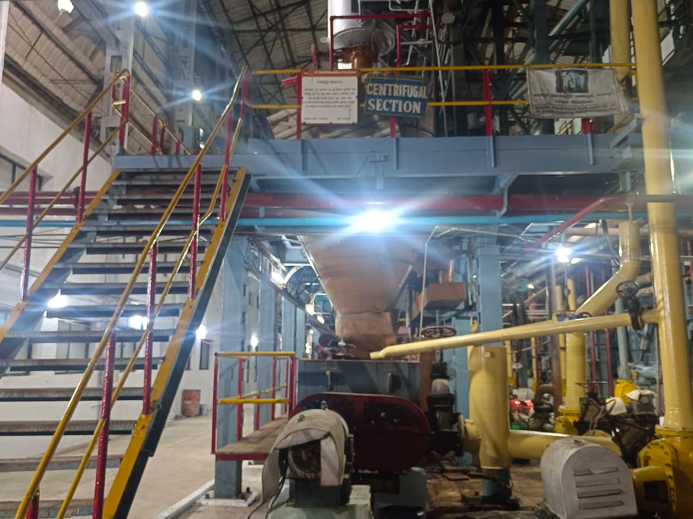
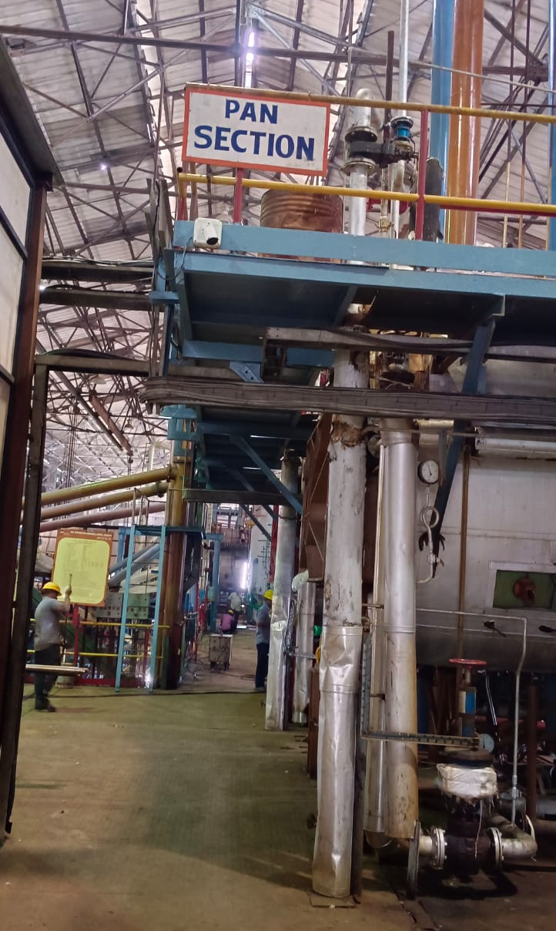
Sugar Processing
Picture 2: (a) Centrifugal section used for separation of sugar crystals from the molasses (b) Pan boiling section: sugar is extracted from mother liquor through crystallization

Slide 5
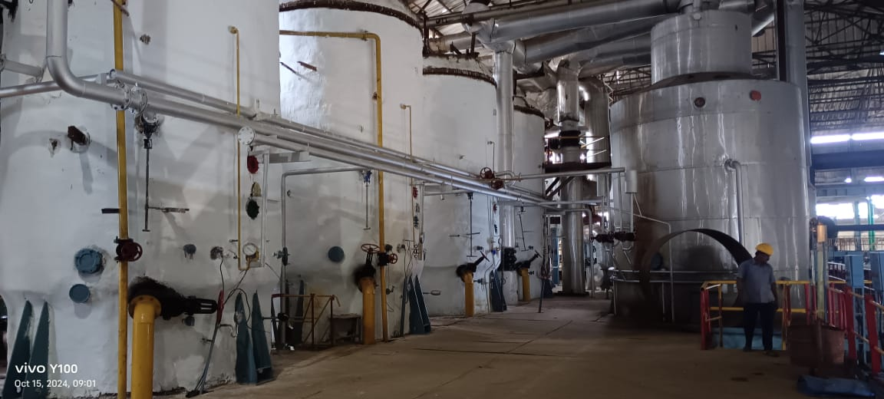
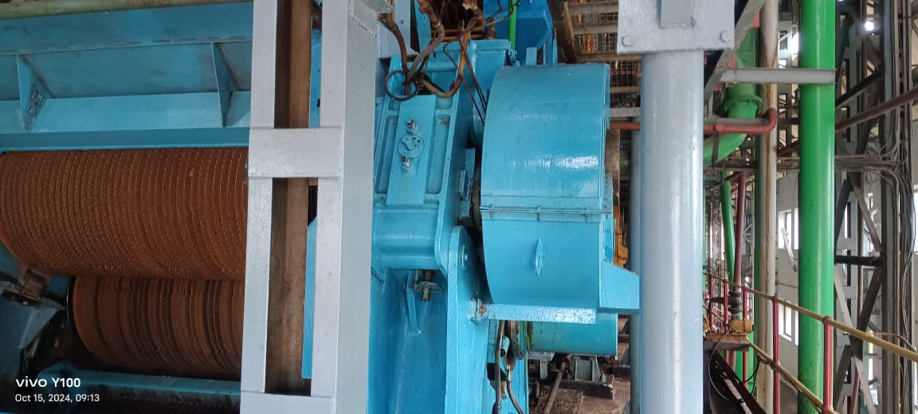
Sugar Processing
Picture 3: (a) Mill house where the cane is crushed to extract juice and (b) Evaporator section: responsible for converting diluted sugar juice into raw sugar and molasses

Slide 6
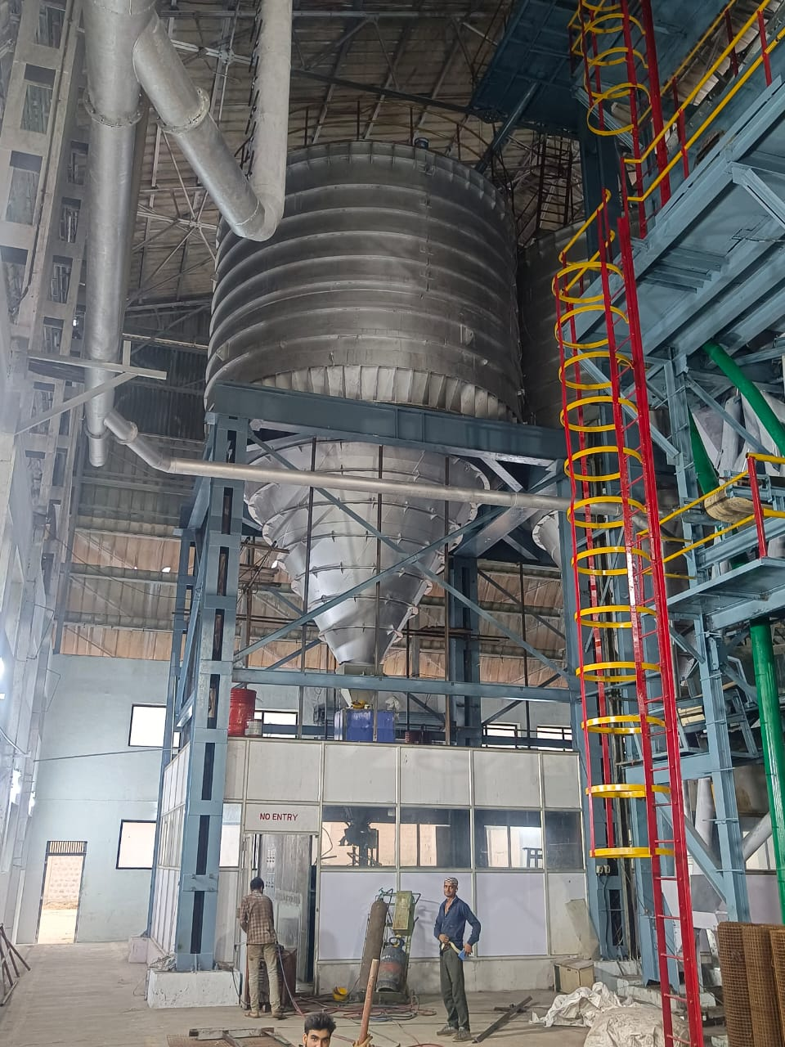
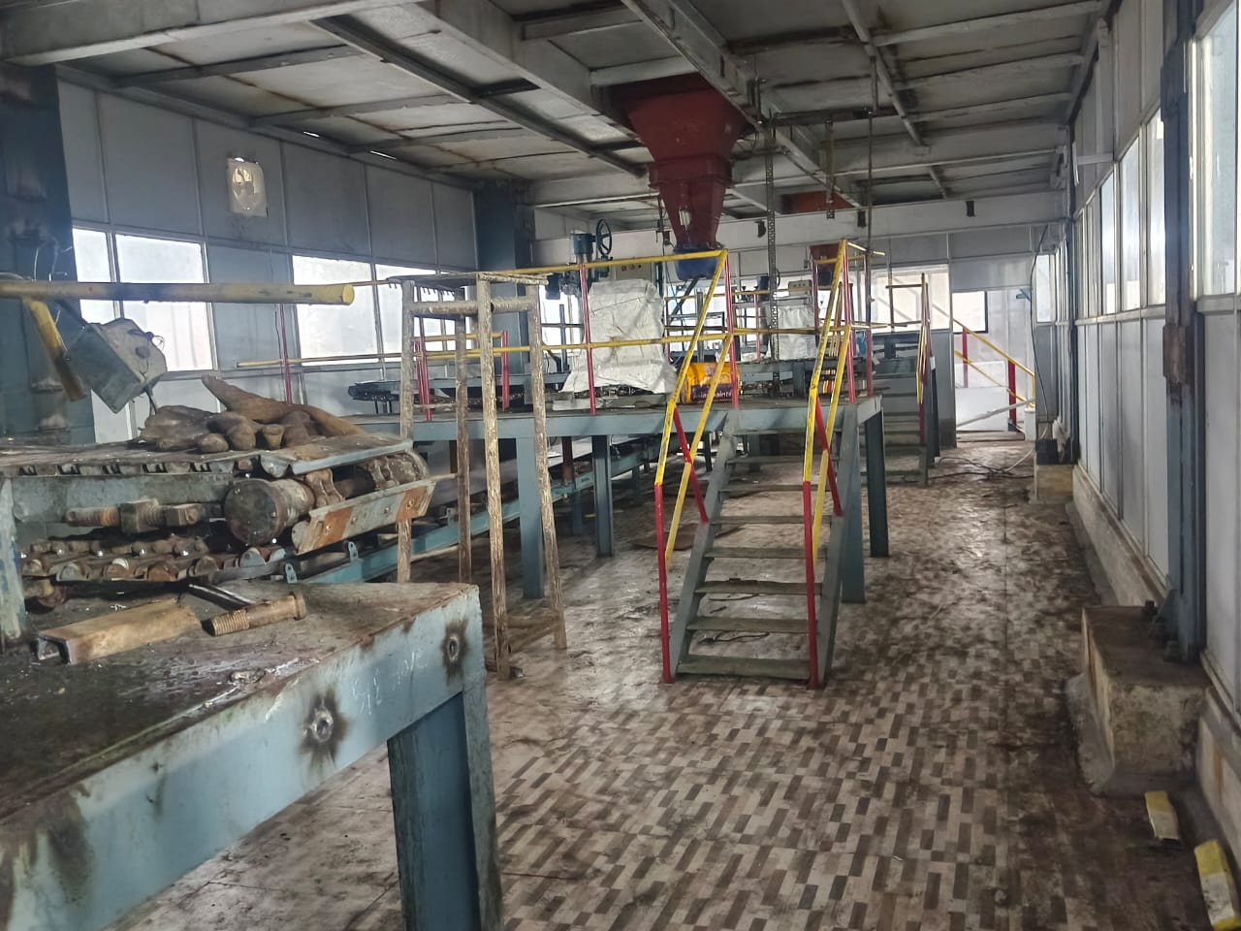
Sugar Packing Section
Picture 4: (a) Sugarhouse bin used to categorize sugar grains by size and (b) Sugar packaging area

Slide 7
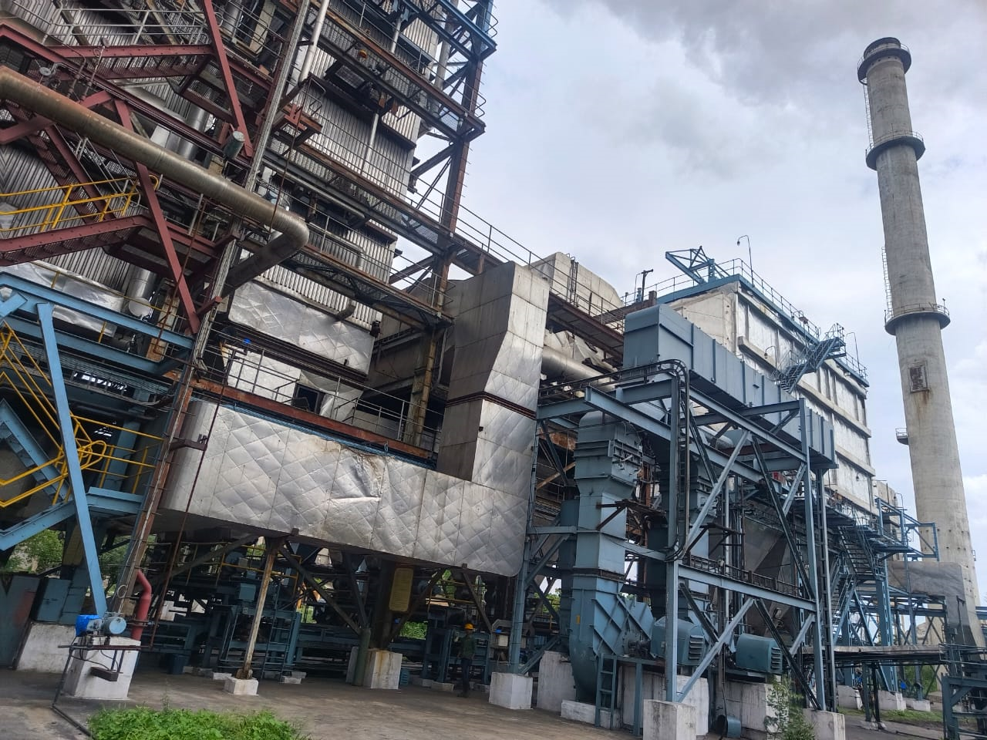
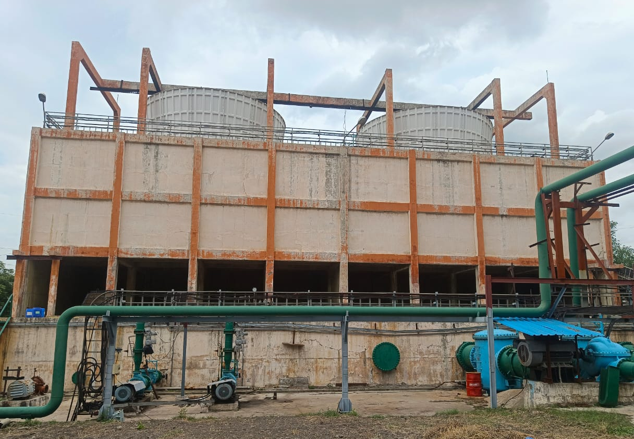
Cogeneration Unit
Picture 5: Boiler section and cogeneration cooling tower

Slide 8
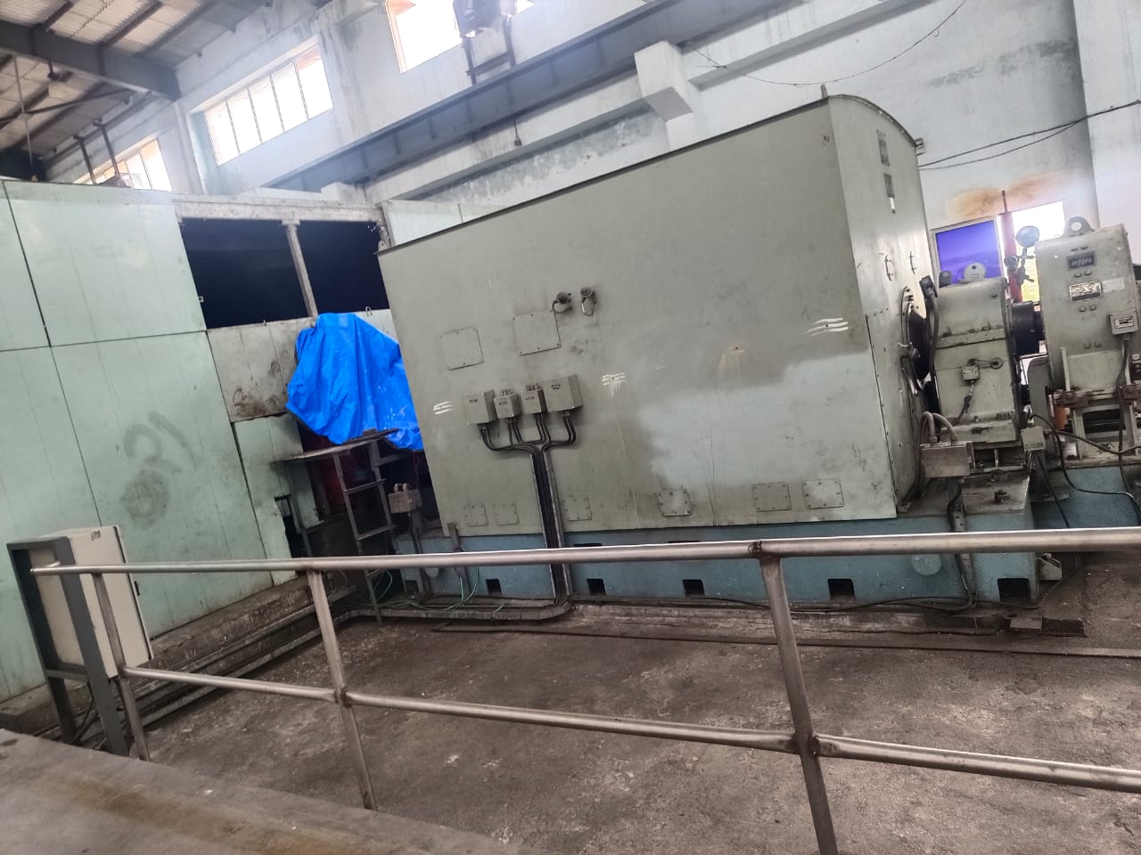
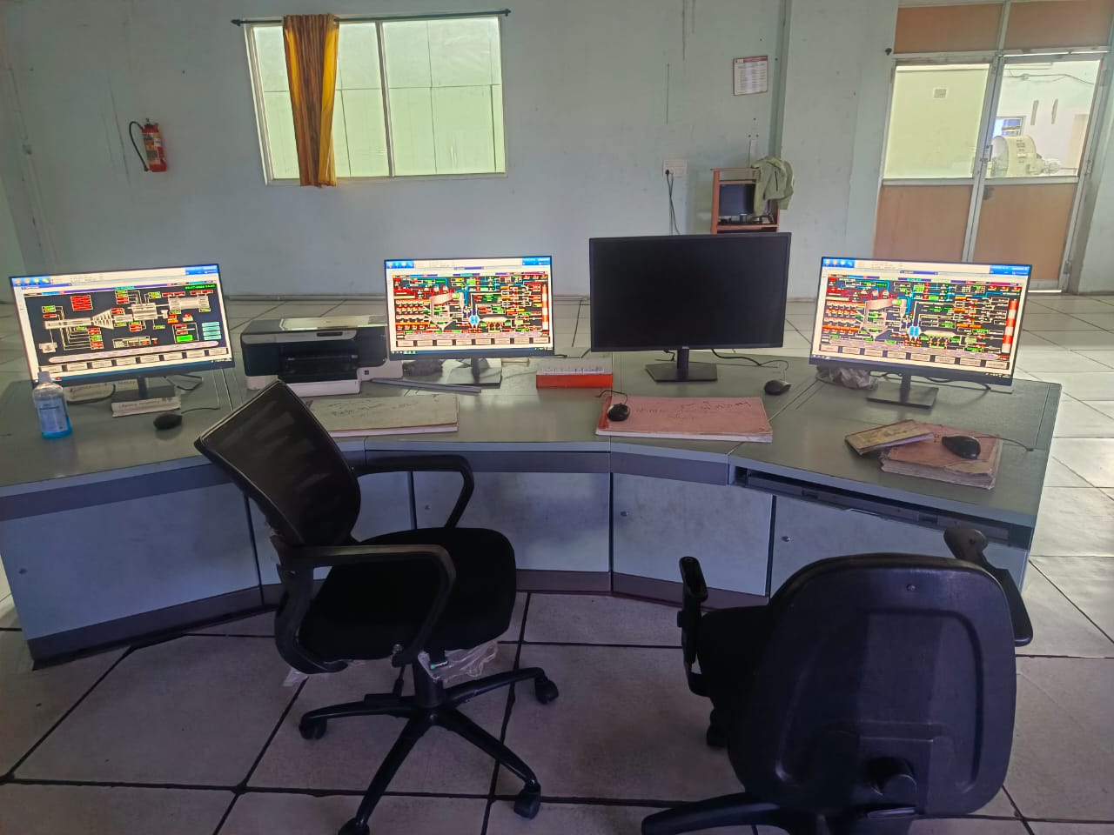
Cogeneration Unit
Picture 6: (a) Turbine section to generate steam for processes and to power and (b) Control room DCS System

Slide 9
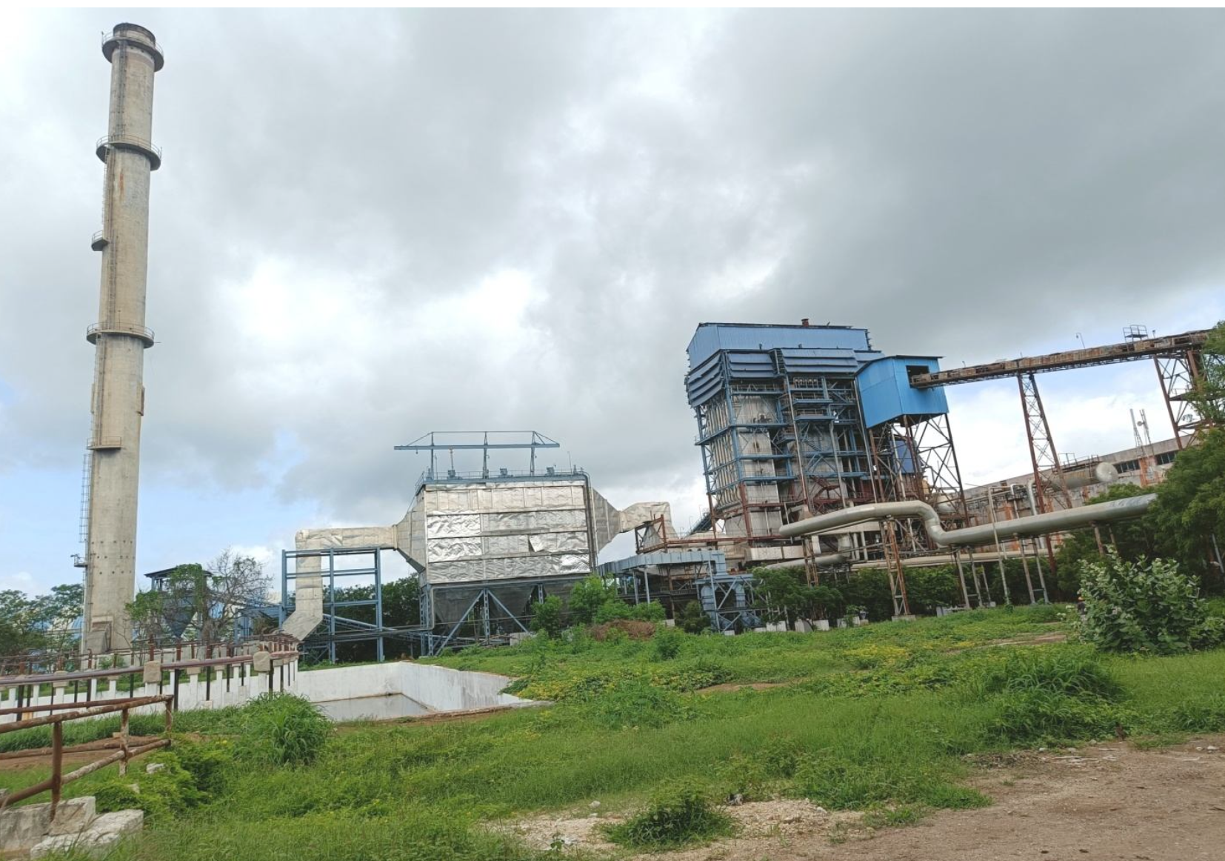
Boiler ESP and Chimney at TSL Unit
Picture 7: View of Boiler ESP and Chimney

Slide 10
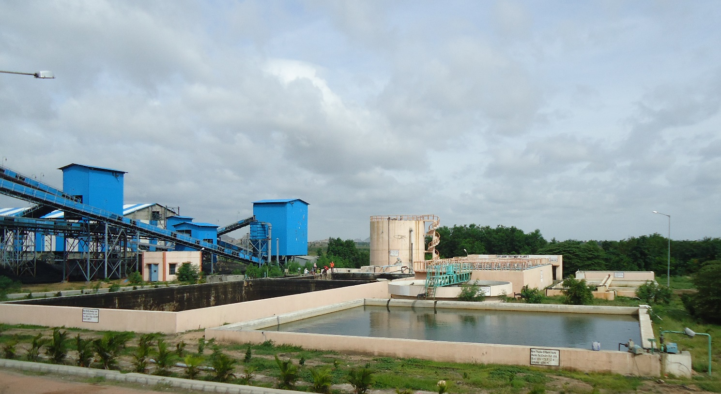
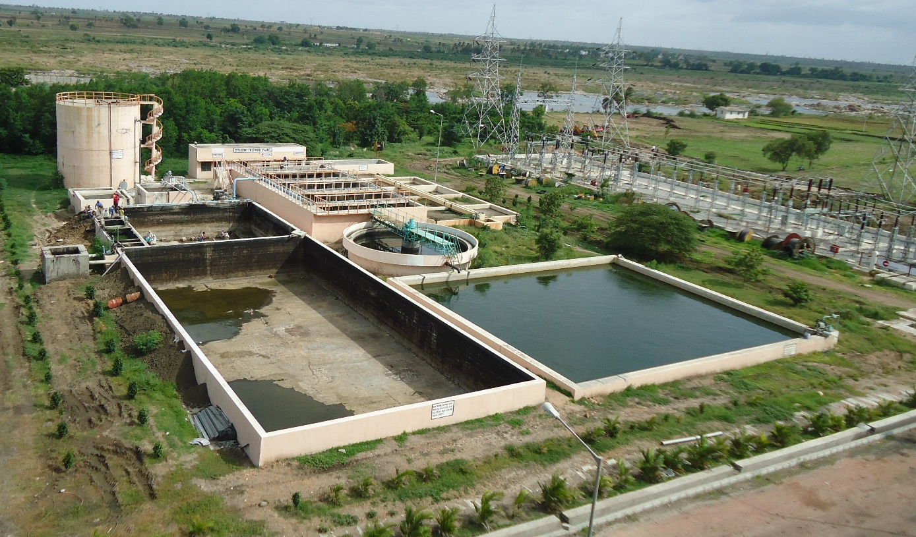
Effluent Treatment Plant (ETP)
Picture 8: Wastewater treatment plant anaerobic system followed by aerobic system

Slide 11


